Slide 1

SkyWalking's 2019-2020 and beyond
Sheng Wu 吴晟, Founding Engineer, Tetrate.io
Apache SkyWalking Founder & V.P. Apache Member

Slide 2
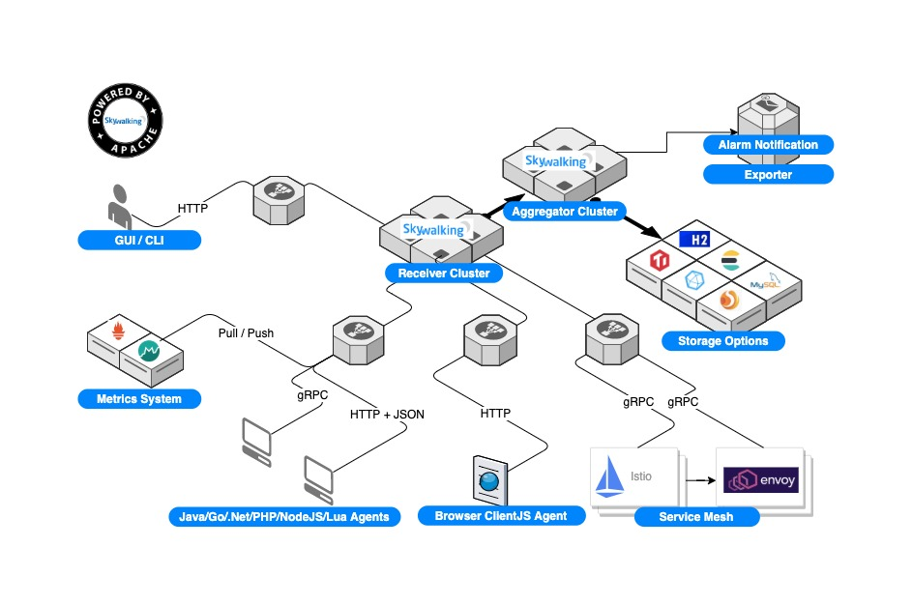
Apache SkyWalking 8.2.0+

Slide 3
Apache SkyWalking’s 2020
发布唯一的7.x版本，放弃对JDK 6和7的支持
专注于8.x版本，v3数据收集协议，v2查询协议。正式发布，并全语言探针覆盖升级
Java, .Net Core, PHP, Python, NodeJS(x2), Golang, Nginx LUA, C++(WIP)
支持Prometheus、OpenTelmetry的metrics数据，支持Spring Sleuth metrics数据
浏览器监控正式发布

Slide 4
Apache SkyWalking’s 2020
性能剖析发布（Java版本）
CLI发布多个版本
Helm 4.0
SkyWalking k8s Operator
SkyWalking在Service Mesh领域，发布ALS， ALS + Metadata Exchange解决方案
SkyWalking Envoy Tracer 由网易和Tetrate贡献给Envoy主库。

Slide 5
STAM: Enhancing Topology Auto Detection For A Highly Distributed and Large-Scale Application System
论文：针对大型分布式应用系统的拓扑自动检测方法
https://wu-sheng.github.io/STAM/

Slide 6
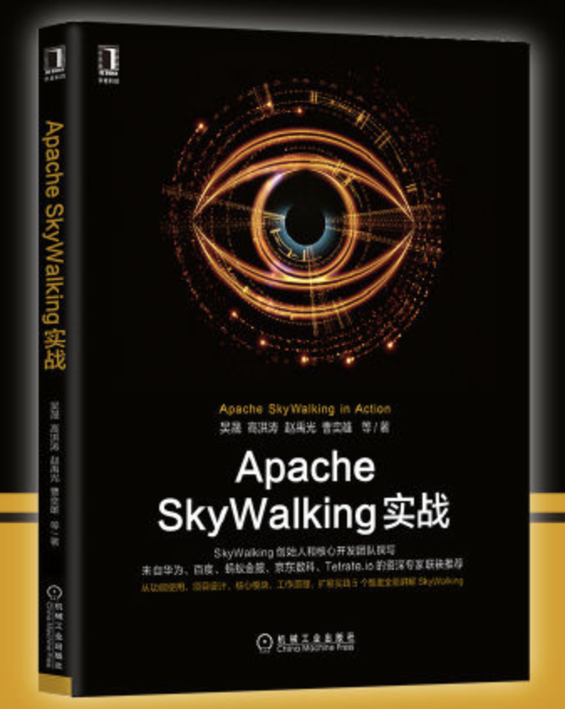

Apache SkyWalking实战，中英文上市

Slide 7
Number Game. Metrics is nothing, just for fun.
 | 2019 | 2020 | 增幅
GitHub Star | 8k~ | 15k+ | 88%
Contributor | 120~ | 280+ | 133%
User | 80+ | 几乎所有一线公司 | -
Committer | 21 | 41 | ~100%
Pull Request |  |  | +680
2019
2020

Slide 8
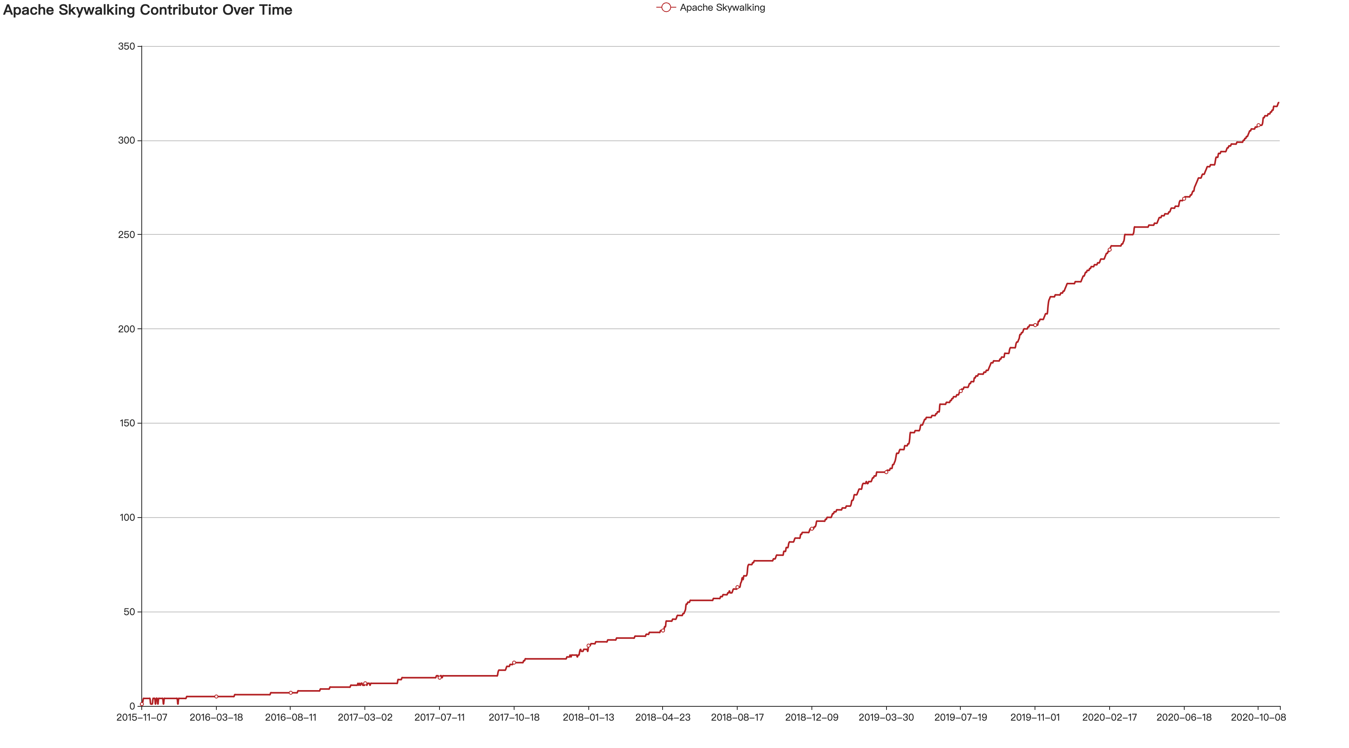

Slide 9
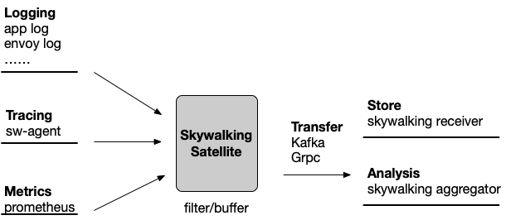
Apache SkyWalking’s unfinished 2020
K8s HPA
SkyWalking Satellite
Istio Telemetry v2
https://docs.google.com/document/d/1TLWOnDWQzVrobez3vy_YvIDa7vt-4F0ToIE2mLok1hw/edit

Slide 10
2021? What’s next?
No plan, open to the community

